Slide 1

Artificial Intelligence
Lecturer
Aurimas Aleksandras Nausėdas
Reverse Image Search

Slide 2
Today you will learn
Reverse Image Search
00
KNN for RIS
01
t-SNE visualizing proximate images
02
Timing the KNN
03
Additional libraries for NN search
04
Further explorations
1

Slide 3
Terms
Computer vision and image classification
Transfer Learning
ImageNet
2

Slide 4
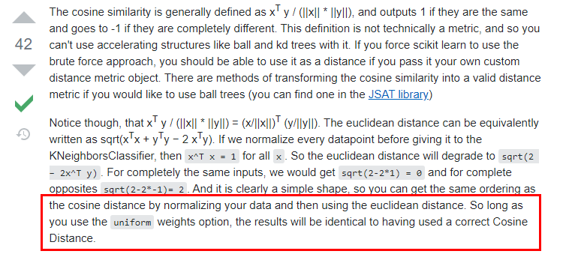
KNN for RIS
Reverse Image Search
We will use KNN to calculate the nearest neighbors
NearestNeighbors(n_neighbors=5, algorithm='brute', metric='euclidean').fit(feature_list)
How about distance metric? We said we are going to prefer cosine distance metric, not euclidian? Actually we can imitate the cosine distance somewhat by normalizing the data and then using euclidean distance, see: https://stackoverflow.com/questions/34144632/using-cosine-distance-with-scikit-learn-kneighborsclassifier
The outputs will not be cosine-like, but the behavior will be similar
Of course, I would invite you to verify it, not just believe it blindly!
3

Slide 5
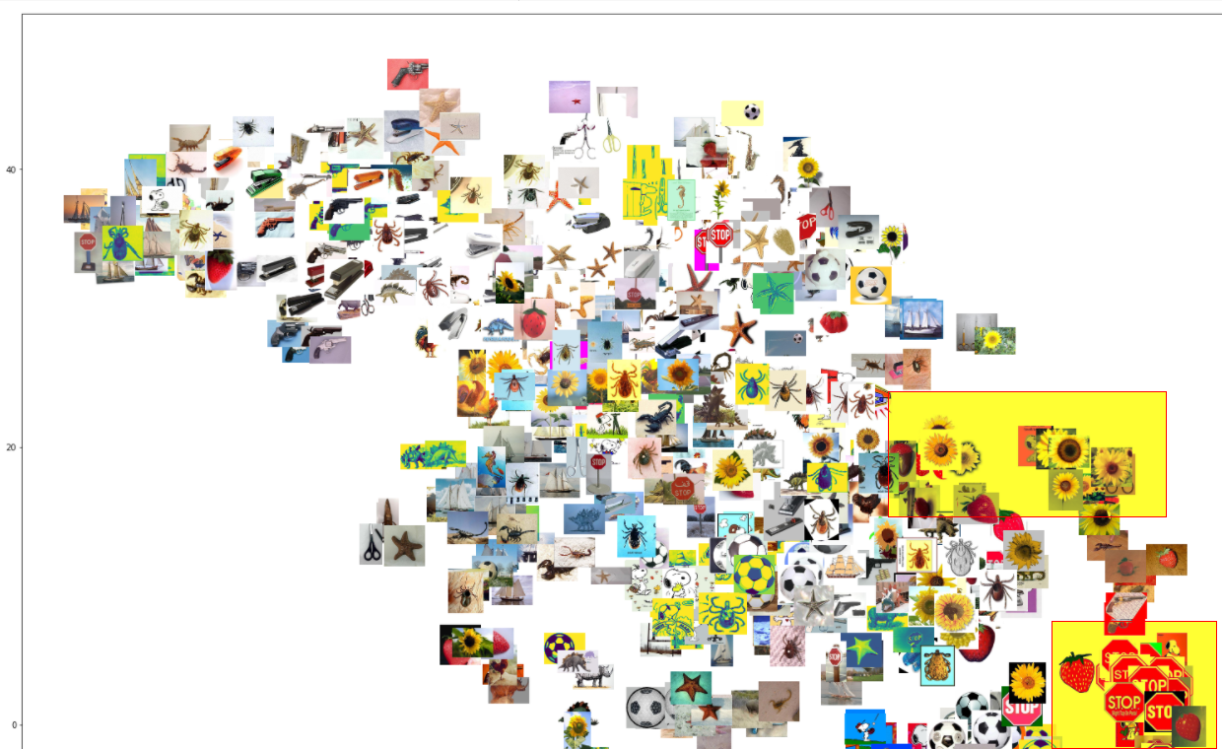
t-SNE visualizing proximate images
Reverse Image Search
4

Slide 6
t-SNE visualizing proximate images
Reverse Image Search
t-SNE (t-distributed stochastic neighbor embedding, pronounced: tee-snee) is a dimenionality reduction that is similar to PCA but has nicer mathematical properties. It is very usefull and often used in the industry to vizualize higher dimensional data projected into a low dimensonal graph / cluster.
TIP: better learn the intenals of PCA and then try to understand t-SNE as it is a bit more complicated and a bit less important then PCA.
Refs:
https://www.datacamp.com/community/tutorials/introduction-t-sne
https://www.youtube.com/watch?v=NEaUSP4YerM
https://www.youtube.com/watch?v=RJVL80Gg3lA - more technical explanation
What is perplexity? The video explains this as the measure of density between plots, that has effects on how the final tsne plot is calculated. A tunnable parameter, there are some indications that higher values produce clearer shapes, ussually it varies between 5 and 50. Getting the most from t-SNE may mean analyzing multiple plots with different perplexities. See:
https://distill.pub/2016/misread-tsne/
https://scikit-learn.org/stable/auto_examples/manifold/plot_t_sne_perplexity.html
5

Slide 7
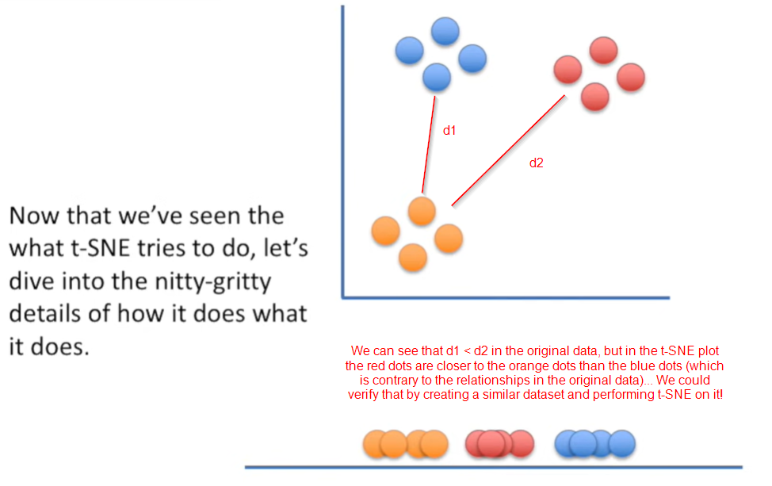
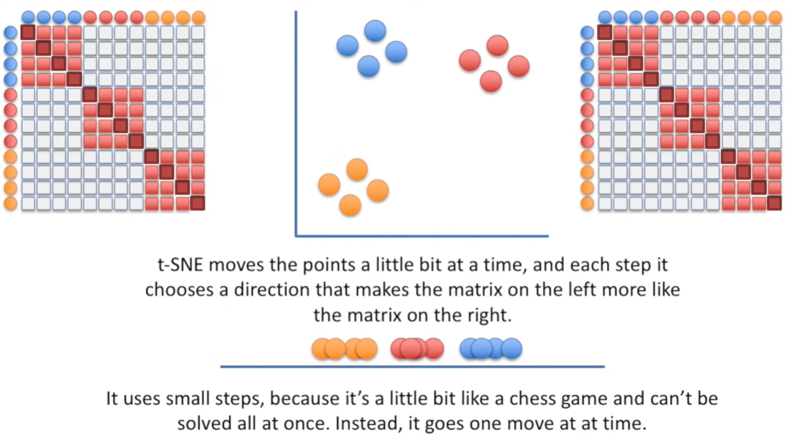
t-SNE visualizing proximate images
Reverse Image Search
//
6

Slide 8
Timing the KNN
Reverse Image Search
In real production RIS app we will most often perform which operation? It will be the operation of finding the nearest neighbors of the image uploaded by the user. This can be optimized!
In general 4 metrics to time and optimize:
Time it takes for CNN to converge (learning time metric)
Time it takes for KNN to converge (learning time metric)
Time it takes to get the N closest neighbours (inference time metric - client impacting)
Time it takes for the CNN to return the feature vector (inference time metric - client impacting)
Optimizations:
Standard features - 1024 (mobilenet) or 2048 (resnet), we can establish a benchmark KNN with standard features the the popular architectures are producing. The feature space if big.
PCA - what are the values for the metrics we care about after performing PCA (100 features)?
Brutefore, Balltree, KDtree - how fast is the KNN with these variations?
Use approximate NN libraries (see next slide)
7

Slide 9
Additional libraries for NN search
Reverse Image Search
Aggregated comparison: https://github.com/erikbern/ann-benchmarks
Annoy
https://github.com/spotify/annoy
https://markroxor.github.io/gensim/static/notebooks/annoytutorial.html
https://stackoverflow.com/questions/57039214/how-to-use-the-spotifys-annoy-library-in-python
Falconn
https://falconn-lib.org/
NMSLib
https://github.com/nmslib/nmslib
https://nmslib.github.io/nmslib/index.html
8

Slide 10
Further explorations
Reverse Image Search
You can explore other libraries to see which ones offers the best performance
Evaluate different experiments (standard features, pca, pca+different knn algs, pca+different aknn libs)
9

Slide 11
Conclusion
Computer vision and image classification
- Transfer Learning | The reuse of prie-trained model on a new problem.
ImageNet | Large Visual database designed for use in visual object recognition software research.
10

Slide 12
Reverse Image Search
Course plan
https://www.codeacademy.lt/programavimo-kursai/dirbtinio-intelekto-studijos/
You can get familiar with it using this link
Detailed course plan
https://docs.google.com/spreadsheets/d/1DmSKXClV4xOkmz-GjKq6ew4EF0cXed6uda5PZYhtEGU/edit?usp=sharing
Slides, tasks and so on
Additional information

